Slide 1
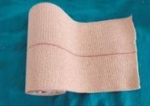
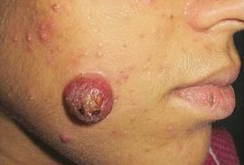
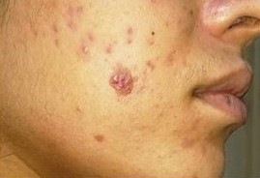
DERMA PEARLS : SURGICAL PEARL - 1
Pyogenic granuloma - A novel approach using pressure therapy
The mainstay of treatments of PG are lasers, excision, cryotherapy, chemical cauterization, sclerotherapy, topical imiquimod or IL bleomycin.
The main concern with these is bleeding, post procedure scarring, or cutaneous necrosis.
Firm application of an elastic adhesive bandage placed over the gauze piece for weekly intervals – A new approach.
After two weeks, this led to a marked reduction in size and vascularity, which aided in the complete removal with minimal scarring.
The significantly smaller lesion left over was easily ablated with CO2 laser, with minimal bleeding.
Journal of Cutaneous and Aesthetic Surgery 16(1):p 60-61, January-March 2023.
IADVL – AP
TEAM GUNTUR
By Dr A.Sirisha

