Slide 1
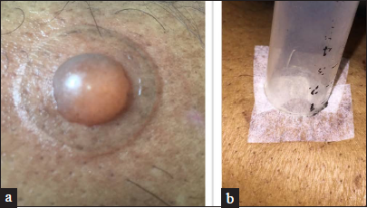
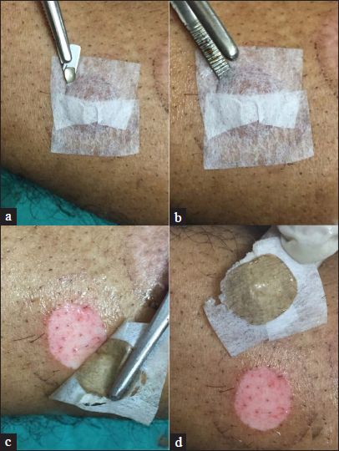
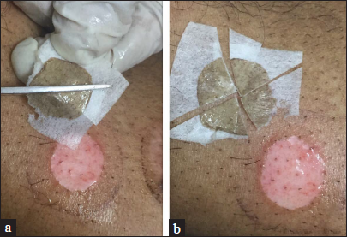
DERMA PEARLS : SURGICAL PEARL - 11
Innovative techniques of splinting blister roof in Vitiligo using micropore tape before harvesting
1
Problem : The blister graft attempts to incurl and wrinkle like a deflated balloon, making it difficult to uncurl the graft after harvesting. Furthermore, if the graft is cut with scissors, it is lost on the periphery.
Solution : Patch each half of the blister with two tiny UV sterilised micropore adhesive tapes and then press with a suction syringe barrel rim at the margin of the blister [Figures 1a and b]. prick the blister at its margin with a blade and gently detached the epidermis from the blister margin with blunt or flat forceps [Figures 2a – d]. Splinting the graft with tape allows it to be identified and sliced into any shape or size and easily transported to the recipient location [Figures 3a and b]. The micropore tape is employed as a template rather than being removed from the graft, and the excess tape is cut off before grafting.
2
3
Mukhtar M. Innovative techniques of splinting blister roof using micropore tape before harvesting. Indian J Dermatol Venereol Leprol 2023;89:638–9.
IADVL – AP (TEAM GUNTUR)
By Dr Keerthi Sidda

