Slide 1
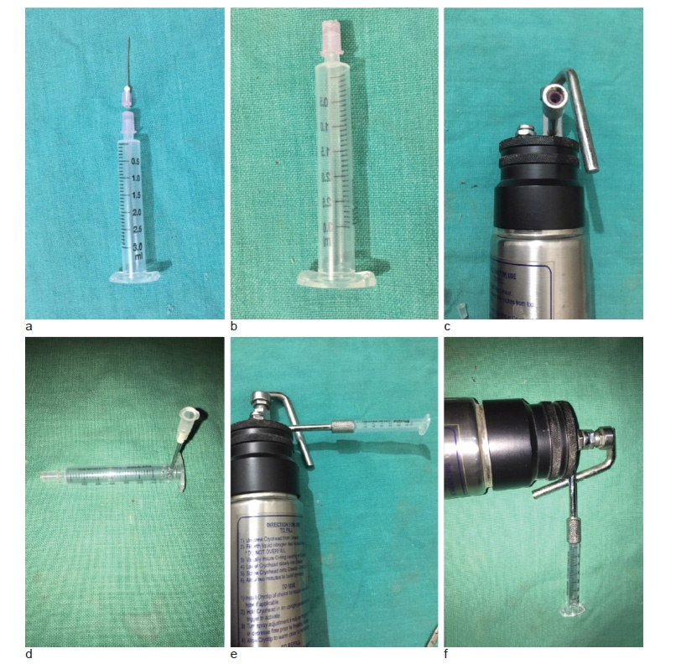
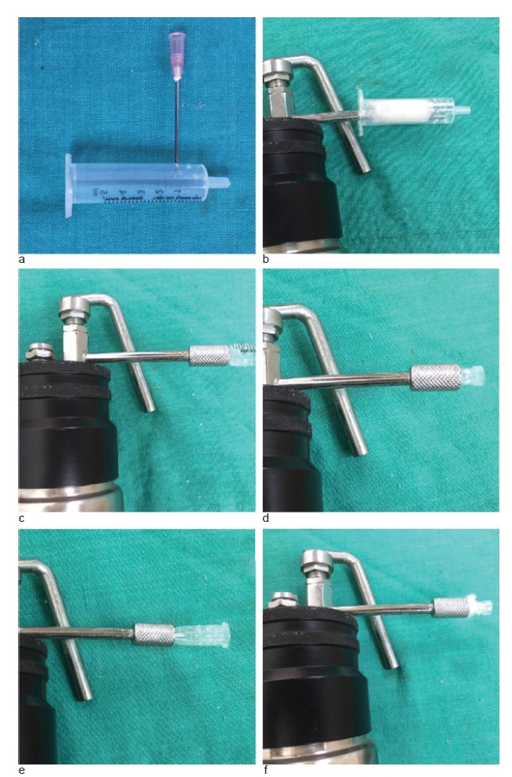
DERMA PEARLS : SURGICAL PEARL - 13
Disposable cryoguard for the cryogun
For procuring aseptic, disposable, transparent cryoguards, disposable syringes (3 to
10ml or more) can be selected according to the diameter of lesions, and then its
barrel is cut at a length of 1 to 2 cm from the needle hub end. After this, the cut
barrel is holed (fenestrated) at 10 to 15 sites with a 16 G needle to allow the escape
of extra cryogen. Following this, the needle is separated from its hub, and the distal
part of the hub is cut to obtain a bigger and more patent hole. This needle hub is
inserted from its cut end into the nozzle of the cryogun.
Advantages of cryoguard : easy to balance the cryogun , maintains uniform distance
of 1 to 2 cm from the skin surface, cryoprobe does not get contagious as it does not
contact the skin lesions. disposable syringes are readily available, cost-effective,
aseptic &disposable. In addition, procedure is visualized due to transparency of guard.
Disposable cryoguards made from syringe (a), needle cap (b), centrifuge tube (c,d),or pipette (e,f).
IADVL – AP (TEAM GUNTUR)
By Dr Keerthi Sidda
Mukhtar M. surgical pearl: disposable cryoguard for cryogun. Iran J Dermatol. 2023; 26(3): 159-161.

