Slide 1
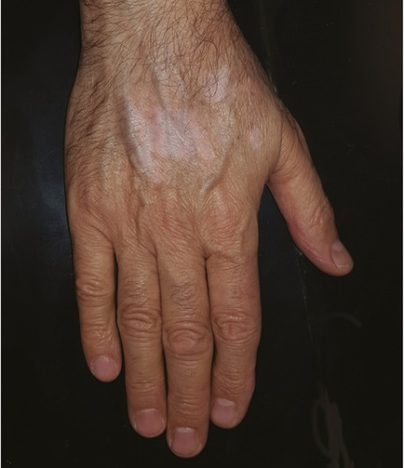
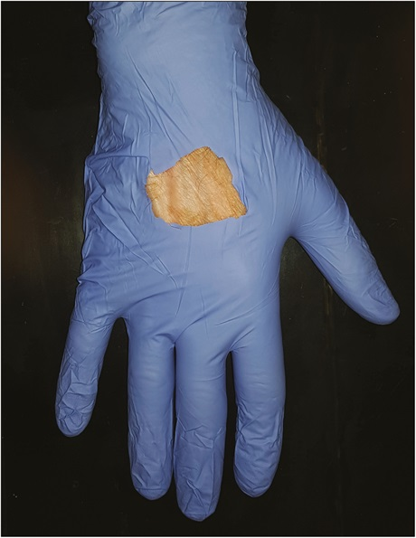
DERMA PEARLS : SURGICAL PEARL - 2
Window approach in conventional phototherapy to protect non-lesional skin
Protection of normal skin during phototherapy, when not using targeted devices, is an issue.
Normal recommendation for protection of unaffected skin includes the use of sunscreens or
shields, especially for sensitive areas
Use of protective coverings—gloves, socks, or clothing, with windows cut out into them, to
ensure that the phototherapy targets only the affected areas.
For the hand, gloves and for the feet,socks could be used. It would also be possible to cut
out windows into tight fitting clothing while administering phototherapy for whole body
lesions.
This could help administer higher doses to the affected area without affecting normal skin,
thereby simulating targeted phototherapy. The same principle could be used for PUVASOL.
IADVL – AP
Journal of Cutaneous and Aesthetic Surgery 15(1):p 89-90, Jan–Mar 2022.
TEAM GUNTUR
By Dr Keerthi Sidda

