Slide 1
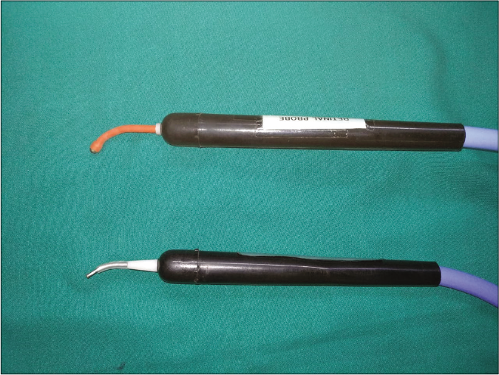
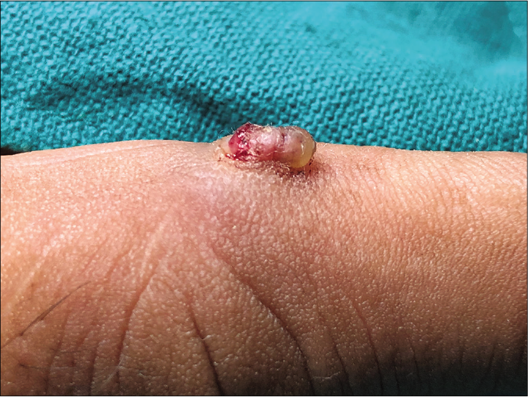
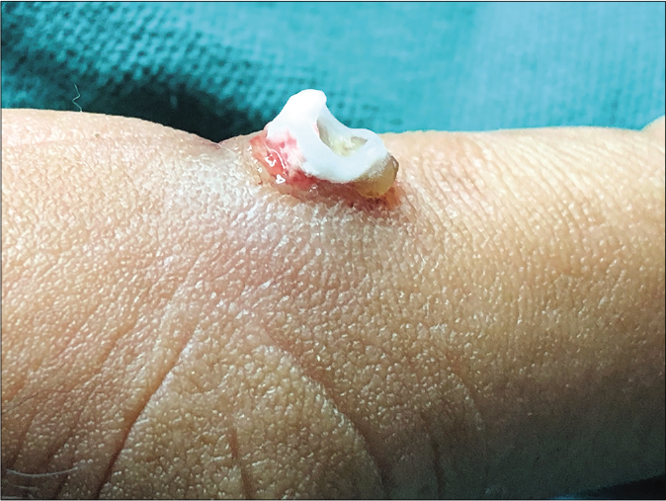
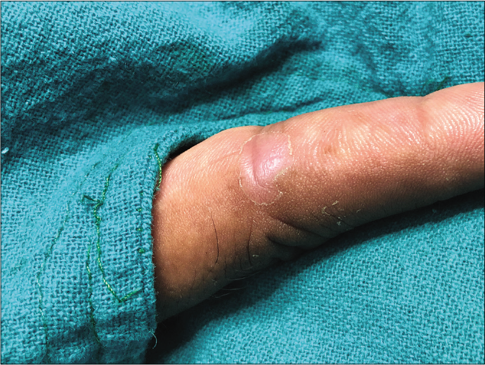
DERMA PEARLS : SURGICAL PEARL - 4
Innovative method to achieve precise cryolysis
To overcome the problem of conventional probes available
for cryotherapy that are larger in size and are not ideal for
treating fine lesions, the cryoprobes which are generally
used in eye surgery can be used [Figure 1].
They are available in sizes ranging from 1.0 mm to 4.0 mm.
They are angulated and provide better precision due to
their smaller size and better handling which makes them
ideal for precise cryolysis, especially in small lesions like
molluscum, warts, etc. This is particularly useful in pediatric
patients who are more apprehensive towards pain and
needles.
Fig 1:Different ophthalmic cryoprobes
Gupta S, Jangra RS, Gujrathi AV, Mahendra A. Innovative method to achieve precise cryolysis. Indian J Dermatol Venereol Leprol 2022;867-8.
IADVL – AP
TEAM GUNTUR
By Dr Keerthi Sidda

