Slide 1

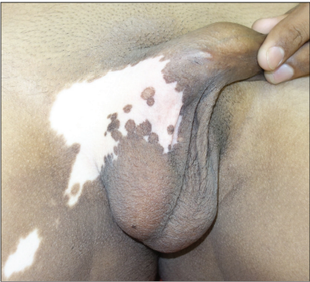
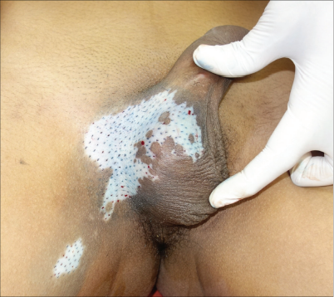
DERMA PEARLS : SURGICAL PEARL - 7
Follicular Unit Extraction as a Treatment Modality for Stable Segmental Inguinoscrotal Vitiligo
Pre op
A 16-year male with stable segmental vitiligo, over the right side of inguinoscrotal region and medial side of right thigh with leukotrichia
Surgical treatment using FUE method was planned
Donor: Grafts from Occipital area
Density given: 6-8 FU/cm²
The grafts were fixed using surgical glue to avoid dressing, thus improving the patient’s compliability, immobility, and enhancing the chances of graft acceptance
After follicle transplantation, the peripheral spread of pigmentation ranged from 5 to 12 mm.
Intra op

Slide 2
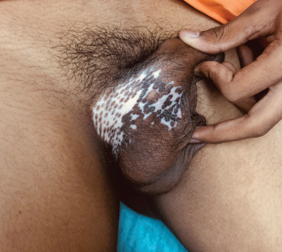
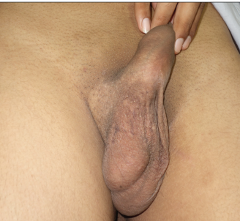
6 weeks post op
Topical tacrolimus and narrow band UVB therapy (NBUVB) were started after 2 weeks of surgery.
Perifollicular repigmentation was noted at the end of 4 weeks over scrotal skin, depigmented patch over thigh showed complete regimentation in 6 weeks .
16 weeks post op
Complete pigmentation over scrotal skin was observed in 16 weeks.
Leukotrichia was not improved with the treatment.

Slide 3
FUE VS other modalities
Method | Comments
Miniature Punch Grafting | Cobble stoning seen
NCMCS | Require Strict Immobility The acceptance of melanin over the region reduces as growing hair beneath the dressing lifts up the harvested melanocytes, thus reducing its surface contact
FUE | No visible scar and hypo- or hyperpigmentation at the donor site. No to minimal Cobble stoning over the recipient site More acceptable color match
The existence of undifferentiated stem cells in hair follicle units serve as a source of the stem cell migration from the graft and then location specific cells proliferation
IADVL – AP
TEAM GUNTUR
Journal of Cutaneous and Aesthetic Surgery 16(4):p 340-2, Oct- Dec 23.
By Dr Rahul Krishna

