Slide 1
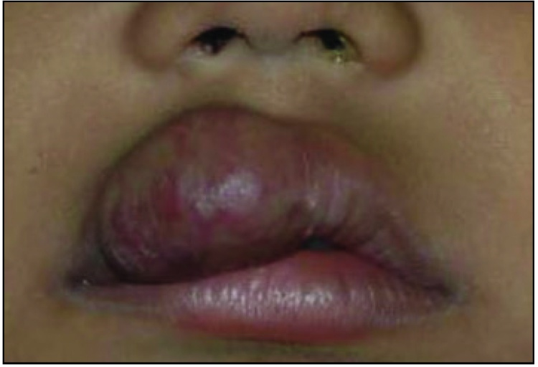
DERMA PEARLS : SURGICAL PEARL - 8
Intralesional radiofrequency ablation followed by lip reduction surgery
for infantile haemangioma of the lip
Infantile haemangioma of the lip [Fig 1a]. is a therapeutically challenging vascular
tumour, given the occurrence of local complications and the long-term risk of a
cosmetically unesthetic lip contour.
Radiofrequency ablation is effective and safe for treating small to moderate-sized lip
hemangiomas. Lip reduction is a complementary technique that can then be used to
remove any residual hemangioma tissue and improve the cosmetic outcome.
Combining these techniques can result in a successful treatment outcome with minimal
cosmetic morbidity and scarring.
Fig1a:Infantile haemangioma of the right upper lip at baseline (before intervention).
Ahuja R, Jain A, Gupta S. Intralesional radiofrequency ablation followed by lip reduction surgery for infantile haemangioma of the lip. Indian J Dermatol Venereol Leprol. 2023 Nov 23:1-3. doi: 10.25259/IJDVL_394_2023. Epub ahead of print. PMID: 38031675.
IADVL – AP (TEAM GUNTUR)
By Dr Keerthi Sidda

Slide 2
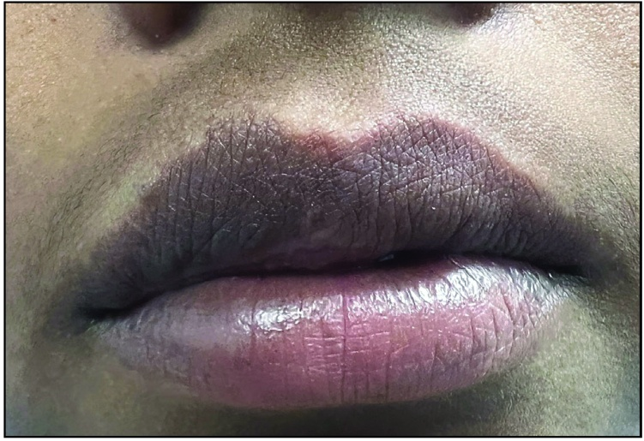
TECHNIQUE: After cleaning and draping, the right side of the upper lip was infiltrated with local anaesthesia (2% w/v lidocaine with epinephrine), starting from the right commissure and progressing medially. Thereafter, a small window was created in the proximal end of the plastic sheath of an 18-G intravenous cannula with a surgical blade inserted into the tissue bulk. A pointed radiofrequency probe set at 20 mW power in coagulation mode was connected to the metallic cannula through the window. The cannula was then moved in different directions, coagulating the tumour tissue .
Postoperatively, the patient was advised analgesics and a topical antibiotic at the point of entry. The patient underwent six sessions of intralesional radiofrequency coagulation over a period of 1 year with about a 50% reduction in the size of swelling [Fig 1b]. With minimal improvement, lip reduction surgery was done to improve the aesthetic outcome further.
Fig 1b:
Reduction in the labial swelling after six
sessions of intralesional radiofrequency
ablation.

Slide 3
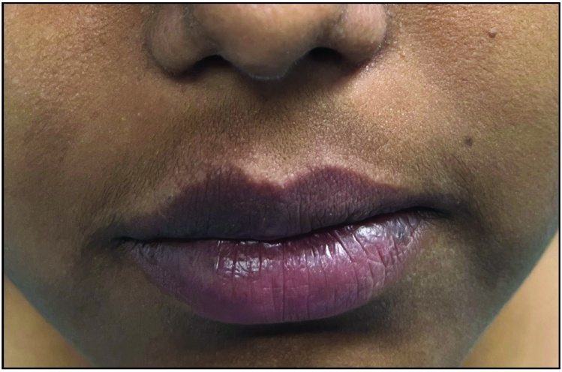
Using an indelible marker, the area to be excised was marked before infiltration anaesthesia. Thereafter, using a 15-number surgical blade, a 3:1 elliptical excision was made, with the width of the excision corresponding to the extent of excess tissue. The amount of tissue bulk to be removed was carefully decided intra-operatively, balancing the ease of wound closure under minimal tension without leaving any extra redundant tissue. Intraoperative haemostasis was achieved using a bipolar radiofrequency probe to coagulate any bleeders during exploration. The labial mucosa was closed in 2 layers with a buried sub-cutaneous suture with 4-0 vicryl and surface approximation with 5-0 prolene. Postoperatively, patient was advised to take oral painkillers and antibiotics. A week later, the sutures were removed.
At 1-month follow-up, the swelling was remarkably reduced. The upper lip contour
had been restored, and so had the philtrum with a smooth curved vermilion border
[Fig 1c].
In this approach, the initial application of radiofrequency ablation not only helped
decrease the tissue volume, facilitating easy surgical debulking thereafter but also
helped achieve better haemostasis because of the coagulation of feeder vessels.
Fig1c:Improved lip contour after six sessions of intralesional radiofrequency ablation and lip reduction surgery.

