Slide 1
DERMA PEARLS : SURGICAL PEARL - 9
NOVEL USE OF CYANOACRYLATE GLUE FOR EFFECTIVE INTRALESIONAL THERAPY IN KELOID
Intralesional injection is a common treatment for keloid. However, because of some follicular openings and comedones on the surface of the keloid on the hairy chest and acne keloidalis, there is a risk of drug leakage, leading to therapy being ineffective.
To prevent drug loss during intralesional injection, cyanoacrylate glue is applied to the follicular and comedone openings on the keloid’s surface [Figure 1].
After 3–5 min, the glue cures, hardens, and seals the openings. Following that, the injection is given into the keloid tissue with a Leur-lock syringe without any drug leakage from the follicular opening.
For the bleeding at the injection sites after the injection therapy, hemostasis also can be achieved with cyanoacrylate glue [Figure 2]

Slide 2
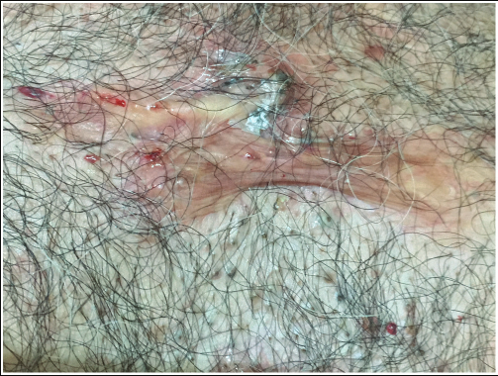
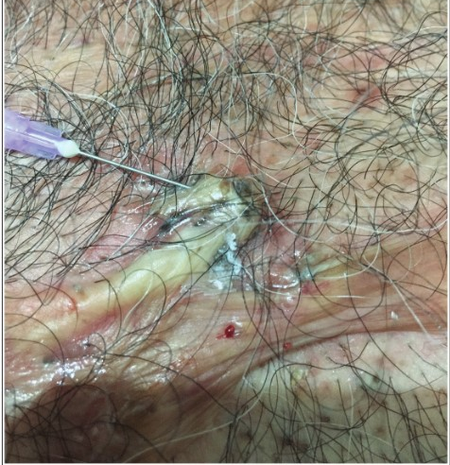
Figure 1: Intralesional injection is given after sealing of follicular openings and comedones on the surface of keloid with cyanoacrylate glue
Figure 2: The post bleeding from injection pricks that are sealed with the glue

Slide 3
Cyanoacrylate is a nonirritant, nonallergenic US FDA proven adhesive glue having antibacterial, antiseptic, dehydrating (moisture absorber due to exothermic heat production), and sealing properties.
The glue remains on the skin for 4–5 days. Usually within a week, it gets dislodged from the follicular openings and skin surface without much effort during taking a bath.
There is no incidence of secondary bacterial infection or any adverse effects of the glue seen at the sites.
If necessary, the glue can be dissolved or easily removed using an acetone solution
Mukhtar M, Mukhtar N. Sealing of follicular openings in keloid with cyanoacrylate glue for effective intralesional therapy. J Cutan Aesthet Surg 2023;16:147-8.
IADVL – AP
TEAM GUNTUR
By Dr Rahul Krishna

